Slide 1
Aviation Family Fund
Dana C. Archibald
August 2021

Slide 3
What is the Aviation Family Fund?
AFF assists in providing supplemental funding during the recovery process for alcohol and drug-related dependence, and is available to anyone in the aviation industry.

Slide 4
Overview
AFF created May, 2011
Since AFF’s inception, over $750K granted!
IRS approved 501©3 nonprofit
All donations are 100% tax deductible
In 2020, AFF helped over 65 people with financial assistance
Provided referrals, information and advice to several hundred people in 2020

Slide 5
Overview
Of all monies received, 95% went to approved applicants
No money is issued directly to the approved applicant
Money is issued directly to institutions
The average grant is between $1500-$2500

Slide 6
What Do We Pay For?
Inpatient
Outpatient
Aftercare
COBRA
Rent
Electric
Mortgage
Water bill
Doctor bills, (AME, P&P Certificates, etc.)
Soberlink
~ We will not provide funding for luxury items ~

Slide 7
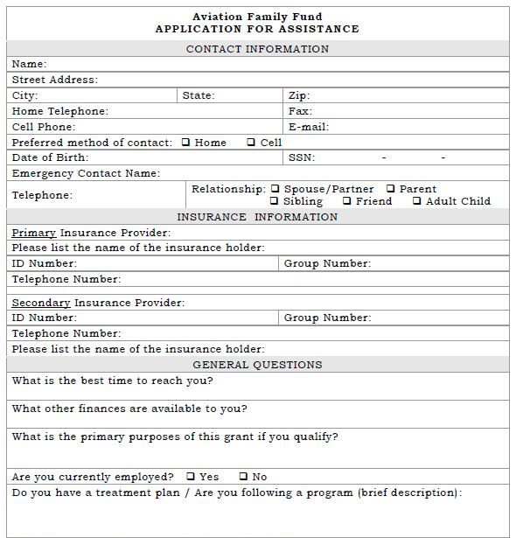
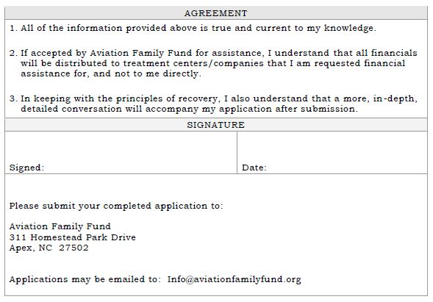
How Does Someone Apply?

Slide 9
How Does One Donate?
Monthly, through your bank’s bill pay
Personal or business check mailed to the address on website
Stock Donations

Slide 10
AFFHOPE
to
44321

Slide 11
Other Kinds of Donations
In-Kind Donations
Providers may offer discounted fees off of standard charges for evaluations and services; tax receipts are sent for all donations and in-kind donations
Providers may limit the amount of discounted cases, or receive referrals, or continue to receive referrals (for existing providers)
For documentation purposes, we can provide our tax ID number. This can be for P&P, HIMS, after care, AME, etc.

Slide 12
Airline Donations

Slide 13
In Conclusion
Aviation Family Fund is a true Nonprofit
NO salaries
NO expense accounts
NO corporate jet
Paper, Ink, and Stamps (to send your tax receipt)
Emailing receipts where applicable

Slide 14
In Memory of Rabbi Dr. Abraham Twerski, 1930-2021

Slide 15
Questions?
Contact Information:
aviationfamilyfund.org
Dana Archibald, President
(919)-608-1735

