Slide 1
HIMS Program Overview
F/O Craig Ohmsieder
Spirit Airlines
National HIMS Chairman
2021 Peer Pilot Conference
Cornerstone of Recovery

Slide 2
Three Main Questions
Why?
What?
How?
Notes:
Why do we need HIMS
What Exactly is HIMS
How does HIMS work

Slide 3
Why do we need HIMS?
Notes:
Let's go back to the 1960’s and 1970’s

Slide 4
Why do we need HIMS?
10% of United States population is Chemically Dependent
Notes:
This is true now
Was true 50 years ago

Slide 5
Why do we need HIMS?
10% of United States population is Chemically Dependent
Are Pilots different? – Data suggested they were
Notes:
Pilots were not going to Treatment Centers
Pilots were not attending Alcohol Help Groups
Pilots were not getting in trouble at work for Drinking

Slide 6
Why do we need HIMS?
Early 1970’s – Human Intervention and Motivation Study
Notes:
Led by ALPA and a group of Doctors
Researched the need for alcohol treatment for pilots

Slide 7
Why do we need HIMS?
Early 1970’s – Human Intervention and Motivation Study
Pilots are the SAME – Just better at hiding it
Notes:
Why are they Better
Why does it appear that Pilots do not suffer from addiction at the same rate as non-pilots?

Slide 8
Why do we need HIMS?
Early 1970’s – Human Intervention and Motivation Study
Pilots are the SAME – Just better at hiding it
Desire to appear professional
Notes:
Pilots have so much invested in their career
So much time
So much Money
They know addiction can take that away
So they build up this Barrier of Professionalism to protect them

Slide 9
Why do we need HIMS?
Early 1970’s – Human Intervention and Motivation Study
Pilots are the SAME – Just better at hiding it
Loyalty among flight crews
Notes:
This stems from the early days of military pilots
A Band of Brothers
I will do anything to protect my fellow Pilots
If you have a problem with drinking too much…I will protect you

Slide 10
Why do we need HIMS?
Early 1970’s – Human Intervention and Motivation Study
Pilots are the SAME – Just better at hiding it
Pilot personality contributes to this - Can go without drinking to get the job done
Notes:
This goes back to Professionalism
The Mission – Completing the Flight – Is the most important thing
I can put my Alcoholic Cravings on Hold to complete the mission
This makes Identification difficult – I haven’t had a drink in 4 Days….How can I have a Problem?

Slide 11
Why do we need HIMS?
Early 1970’s – Human Intervention and Motivation Study
Pilots are the SAME – Just better at hiding it
Pilot schedules promote binge drinking
Notes:
2 Different Scenarios Here:
1- Pilot is perfect Husband & Father at Home – Schedules flying to have Great “Drinking” overnights in great Cities with Great Bars – Almost Always goes alone w/o other Crew – nearly impossible to detect
2- Pilot drinks non-stop at home – Schedules flying for minimal work and never touches a drop of alcohol on his trip – Back home a few days later and drinks non-stop
This becomes a problem for the pilot when the two Overlap – One is not enough, and they must now drink at home and on trips – Now it is much harder to hide

Slide 12
Why do we need HIMS?
Early 1970’s – Human Intervention and Motivation Study
In 1974 the HIMS Program was established
Notes:
With all that said, and all that research done: HIMS was established

Slide 13
What is HIMS?
Notes:
So what exactly is HIMS?

Slide 14
What is HIMS?
HIMS is a Pilot Specific Model
Notes:
First of all: It’s a Pilot Specific Model
Pilots have specific needs – Both in Treatment and in Re-Certification that must be met
HIMS addresses these needs
So, what we have is -

Slide 15
What is HIMS?
HIMS is a Pilot Specific Model
A Safe and Effective way for Pilots with Substance Use Problems to get Help while Protecting their Flying Careers
Notes:
This is HIMS – But HIMS is also a few other things-

Slide 16
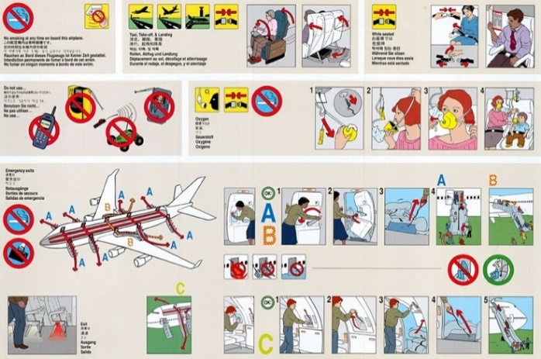
What is HIMS?
HIMS is a SAFETY Program
Notes:
This is the Primary goal
This is #1

Slide 17
What is HIMS?
HIMS is a SAFETY Program
Protect the Public / Flying Profession
Notes:
We cannot have an impaired pilot flying an airplane
Protecting the flying public
Protecting the flying profession

Slide 18
What is HIMS?
HIMS is a SAFETY Program
Protect the Public / Flying Profession
Save the Life
Notes:
Save the life of the pilot
Alcoholism and Drug addiction are Fatal if left untreated
The road for an alcoholic always ends in either Jails, Institutions, or Death
They will stop drinking by being locked up in Jail
They will stop drinking by being locked up in a mental hospital
They will stop drinking because of death
Treatment and Recovery is the only other option

Slide 19
What is HIMS?
HIMS is a SAFETY Program
Protect the Public / Flying Profession
Save the Life
Save the Family
Notes:
Alcoholism truly is a Family Disease
In my 20+ years of HIMS – I have seen so many families saved

Slide 20
What is HIMS?
HIMS is a SAFETY Program
Protect the Public / Flying Profession
Save the Life
Save the Family
Save the Career
Notes:
Again…in 20+ years of HIMS – I have only seen a handful of cases where the pilot could not return to flying
Most of those were the pilot choosing drinking over flying or having a co-existing condition that prevented it
What else is HIMS?

Slide 21
What is HIMS?
HIMS is a MONITORING and SUPPORT Program

Slide 22
What is HIMS?
HIMS is a MONITORING and SUPPORT Program
The FAA and the Airline use HIMS to evaluate the Pilot’s Recovery and Return to Flying

Slide 23
What is HIMS?
HIMS is a MONITORING and SUPPORT Program
The FAA and the Airline use HIMS to evaluate the Pilot’s Recovery and Return to Flying
There is a built-in Support System to assist the Pilot through the entire HIMS Process
Notes:
So, the pilot is provided with all the tools needed to build a life in recovery away from alcohol and drugs
The pilot is given a support program to help him through all this
The FAA and the Airline also use that support program to monitor the pilot’s progress and evaluate when he is ready to return to flying
All of this is referred to as the HIMS Process

Slide 24
What is HIMS?
HIMS is a Process
How does HIMS work?
Notes:
What exactly is this Process?

Slide 25
How does HIMS work?
The HIMS PROCESS
Notes:
The steps are:

Slide 26
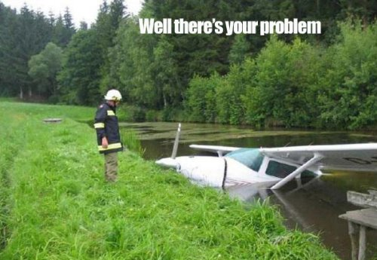
How does HIMS work?
The HIMS PROCESS
Identification / Evaluation
Notes:
First is Identification and Evaluation

Slide 27
Identification / Evaluation
Who has the alcohol problem?
Notes:
This can be Difficult
As said earlier, Pilots are very good at hiding their drinking problems
It is very hard to just look at a pilot and say “He has the Problem”
And Most Pilots will not just come forward and Say “I’m drinking too much, and I need Help”

Slide 28
Identification / Evaluation
1. Does your drinking / using cause problems?
-Legal
-Relationship
-Employment
Notes:
So we have to ask questions -

Slide 29
Identification / Evaluation
1. Does your drinking / using cause problems?
-Legal
-Relationship
-Employment
2. Can you predict how many drinks you will have and what
will happen once you start drinking / using?
Notes:
Most alcoholics and addicts will set limits for how much they will consume – and almost always break that limit

Slide 30
Identification / Evaluation
1. Does your drinking / using cause problems?
-Legal
-Relationship
-Employment
2. Can you predict how many drinks you will have and what
will happen once you start drinking / using?
3. Do you have to hide your drinking?
Amounts, bottles, geograpically
(Pre-drinking / Only had 2!)
Notes:
Hide Bottles at Home
Make really strong Mixed drinks –
Do you do things that make it appear you are drinking less?
Drink several on your own before you meet with rest of crew – appears you are drinking less

Slide 31
Identification / Evaluation
ALL Addicts need Consequences to break delusion
Layover Incidents
Peer Concerns
DUI / Illegal Possession
Failed Alcohol / Drug Test
Sick Leave
Training Issues
Family Problems
Notes:
If we can lay out these issues in front of them, these consequences… one by one…
They can start to recognize they may have a problem

Slide 32
Identification / Evaluation
My Goals
Get the pilot to see - there may be a “Problem”
Get the pilot to agree to a Professional HIMS Evaluation
Notes:
Again:

Slide 33
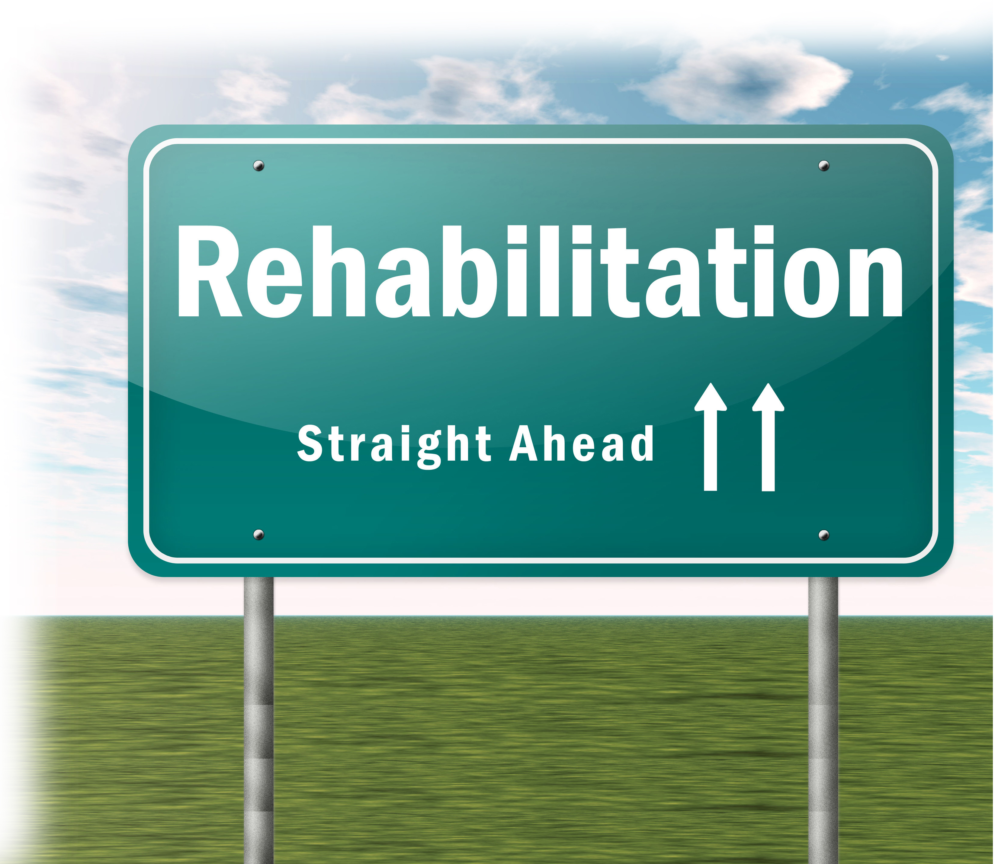
How does HIMS work?
The HIMS PROCESS
Identification / Evaluation
Treatment
Notes:
If the Pilot is Diagnosed then we move on to Treatment

Slide 34
Treatment
A Comprehensive Program for the Pilot
In-Patient Residential
With other Pilots / Professionals
28 Days +
Staff is trained to work with HIMS / Pilots
Prepares Pilot for life in Recovery

Slide 35
How does HIMS work?
The HIMS PROCESS
Identification / Evaluation
Treatment
Recovery Program (AA/NA)
Notes:
While the pilot is in Treatment – we introduce and get him started on a Recovery Program
Once the pilot gets out of treatment – everything they do centers around their Recovery Program

Slide 36
Recovery Program
A New Way of Life for the Pilot
Alcoholics Anonymous (AA) is best known but there are others
Requires Rigorous Honesty
Requires change in all aspects of Pilot’s life
Requires the Pilot to open up to Others
Progress not Perfection

Slide 37
How does HIMS work?
The HIMS PROCESS
Identification / Evaluation
Treatment
Recovery Program (AA/NA)
Aftercare
Notes:
Something else that starts immediately after Treatment is Aftercare
Anyone can stay Sober locked in a Treatment Center
Aftercare helps bridge the gap between treatment and this new way of life

Slide 38
Aftercare
The Transition from Treatment to Sober Life
Group Setting
HIMS Trained Group Leader
With other Pilots / Professionals
Weekly Meetings
Reports sent to HIMS AME / IMS
Notes:
Details of meetings are not sent in reports, but the Pilot’s participation and overall progress in recovery are included

Slide 39
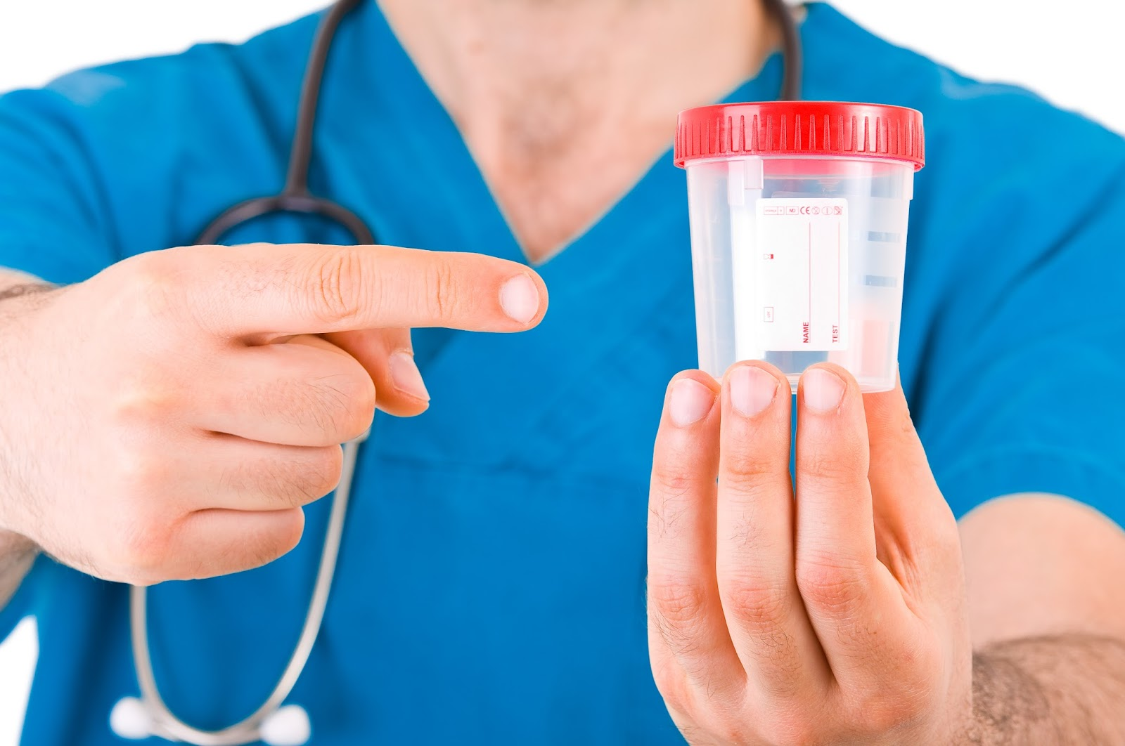
How does HIMS work?
The HIMS PROCESS
Identification / Evaluation
Treatment
Recovery Program (AA/NA)
Aftercare
No Notice Alcohol / Drug Testing
Notes:
Another Key part of the HIMS Process -

Slide 40
No Notice Alcohol/Drug Testing
Trust but Verify
Separate from Random DOT Testing
Minimum of 14 tests per 12 months
Both On and Off Duty Testing
Should adjust per individual Pilot –
ETG Test
Hair/Nails
Is very accurate – But still One data point
Notes:
Always look at the Big Picture

Slide 41
How does HIMS work?
The HIMS PROCESS
Identification / Evaluation
Treatment
Recovery Program (AA/NA)
Aftercare
No Notice Alcohol / Drug Testing
Psychological & Psychiatric Evaluations

Slide 42
Psychological & Psychiatric Evaluation
Does their Mental Condition allow for a Safe Pilot?
Evaluations are by HIMS Trained Doctors
Pilot should be well established in Recovery
Should not begin evaluations if any residual effects of long-term alcohol use are present
Notes:
Evaluators are looking for a completely changed lifestyle – this takes time

Slide 43
How does HIMS work?
The HIMS PROCESS
Identification / Evaluation
Treatment
Recovery Program (AA/NA)
Aftercare
No Notice Alcohol / Drug Testing
Psychological & Psychiatric Evaluations
Peer Pilot Monitoring
Notes:
This is another pilot who can come alongside this new pilot in recovery and help them along the way
-Teammate
-Guide
-Mentor
-Also an Evaluator

Slide 44
Peer Pilot Monitoring
A Trusted Volunteer
Must be HIMS Trained
Ideally has been through HIMS as well
Is a Resource and an Advocate
Must also Hold Pilot Accountable
Meets multiple times per month
Reports sent to HIMS AME / IMS

Slide 45
How does HIMS work?
The HIMS PROCESS
Identification / Evaluation
Treatment
Recovery Program (AA/NA)
Aftercare
No Notice Alcohol / Drug Testing
Psychological & Psychiatric Evaluations
Peer Pilot Monitoring
Company Pilot Monitoring
Notes:
Very Similar to Peer Pilot Monitor
From more of a position of authority

Slide 46
Company Pilot Monitoring
A member of Airline Management
Must be HIMS Trained
Helps pilot adjust in Return to Flying
Is a Resource and an Advocate
Must also Hold Pilot Accountable
Meets at least once a month
Reports sent to HIMS AME / IMS

Slide 47
How does HIMS work?
The HIMS PROCESS
Identification / Evaluation
Treatment
Recovery Program (AA/NA)
Aftercare
No Notice Alcohol / Drug Testing
Psychological & Psychiatric Evaluations
Peer Pilot Monitoring
Company Pilot Monitoring
The HIMS AME / IMS
Notes:
The final piece of the puzzle that brings everything together is the Pilot’s HIMS Doctor

Slide 48
HIMS AME / IMS
The Manager of the Team
He Guides the HIMS Process
He collects all Reports on the HIMS Pilot
He Evaluates the Pilot’s Progress
Should establish a Relationship with the Pilot
Makes Final Decision on when to request Return to Flight status with the FAA
Notes:
The FAA can not do an in-depth evaluation on every pilot –
They trust the HIMS Trained Aviation Doctor to do this evaluation for them
This Doctor then sends a complete packet to the FAA explaining and Documenting why the Pilot should be Returned to Flying

Slide 49
How does HIMS work?
The HIMS PROCESS
Identification / Evaluation
Treatment
Recovery Program (AA/NA)
Aftercare
No Notice Alcohol / Drug Testing
Psychological & Psychiatric Evaluations
Peer Pilot Monitoring
Company Pilot Monitoring
The HIMS AME / IMS
Notes:
These 7 steps of the HIMS Process are also included in the pilot’s monitoring program

Slide 50
Step-Down Monitoring Process
Describes Monitoring after Pilot returns to Flying
Lifetime Abstinence is Required
Trust but Verify
Start with very strict requirements
Requirements are relaxed as Time and a Strong Foundation in Recovery are built
Encourage Pilot to help others in HIMS
Notes:
Which leads us to the Step-Down Monitoring Process

Slide 51
Does HIMS Work?
Notes:
I first came into HIMS in 1997
Through Multiple DUI’s – Extensive Drug and Alcohol Use – Calling in Sick over and over and over
Relapse – I came into HIMS then went back out drinking – Then back into HIMS
I was: Bad Husband – Bad Father – Bad Employee
Because there was a HIMS Program – Because of people there to help me in spite of all the bad I had done-
Through HIMS – I completely Turned my life around
Good Husband – Good Father – Good Employee
Pilot Peer Monitor
HIMS Chairman for my Airline - National HIMS Chairman
I could tell story after story of Pilot’s lives and careers that have been saved through HIMS
It really does work

Slide 52
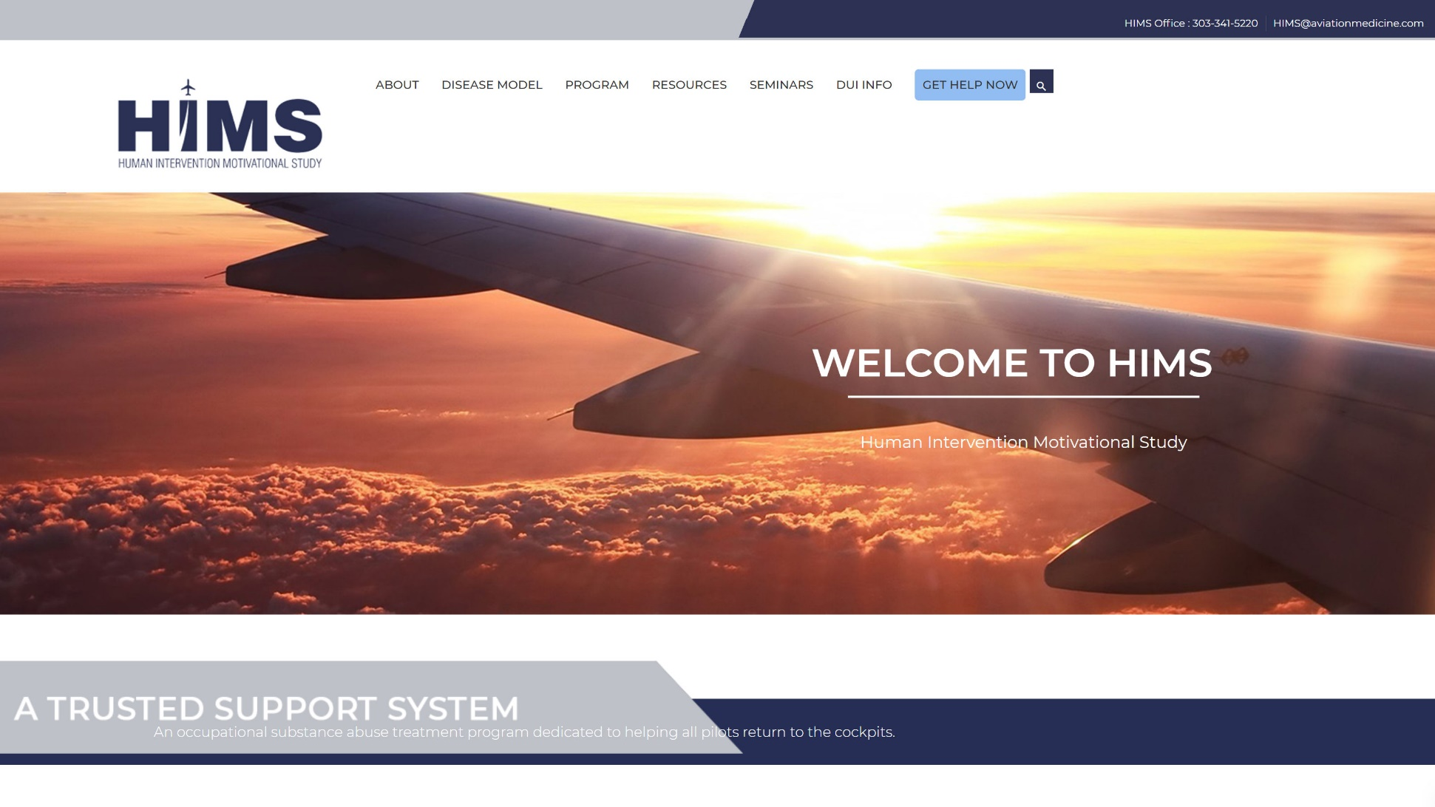
HIMS Website
www.HIMSProgram.com

Slide 53
Questions??
FO Craig Ohmsieder
ALPA Int’l HIMS Chairman
(770) 519-5407
craig.ohmseider@alpa.org
Capt. Billy Petersen
ALPA Int’l HIMS Vice Chairman
(516) 818-8495
william.petersen@alpa.org
Dr. Quay Snyder
ALPA Aeromedical HIMS Program Manager
(303) 341-4435 (AMAS)
doctors@aviationmedicine.com

