Slide 1
Addiction Is A Disease
Danyelle C. Smith, MA, LPC-MHSP, NCC
Therapist
Tuesday, 8/24/21
4726 Airport Highway, Louisville, Tennessee 37777 | cornerstoneofrecovery.com | © 2020, The Cornerstone of Recovery, Inc.

Slide 2
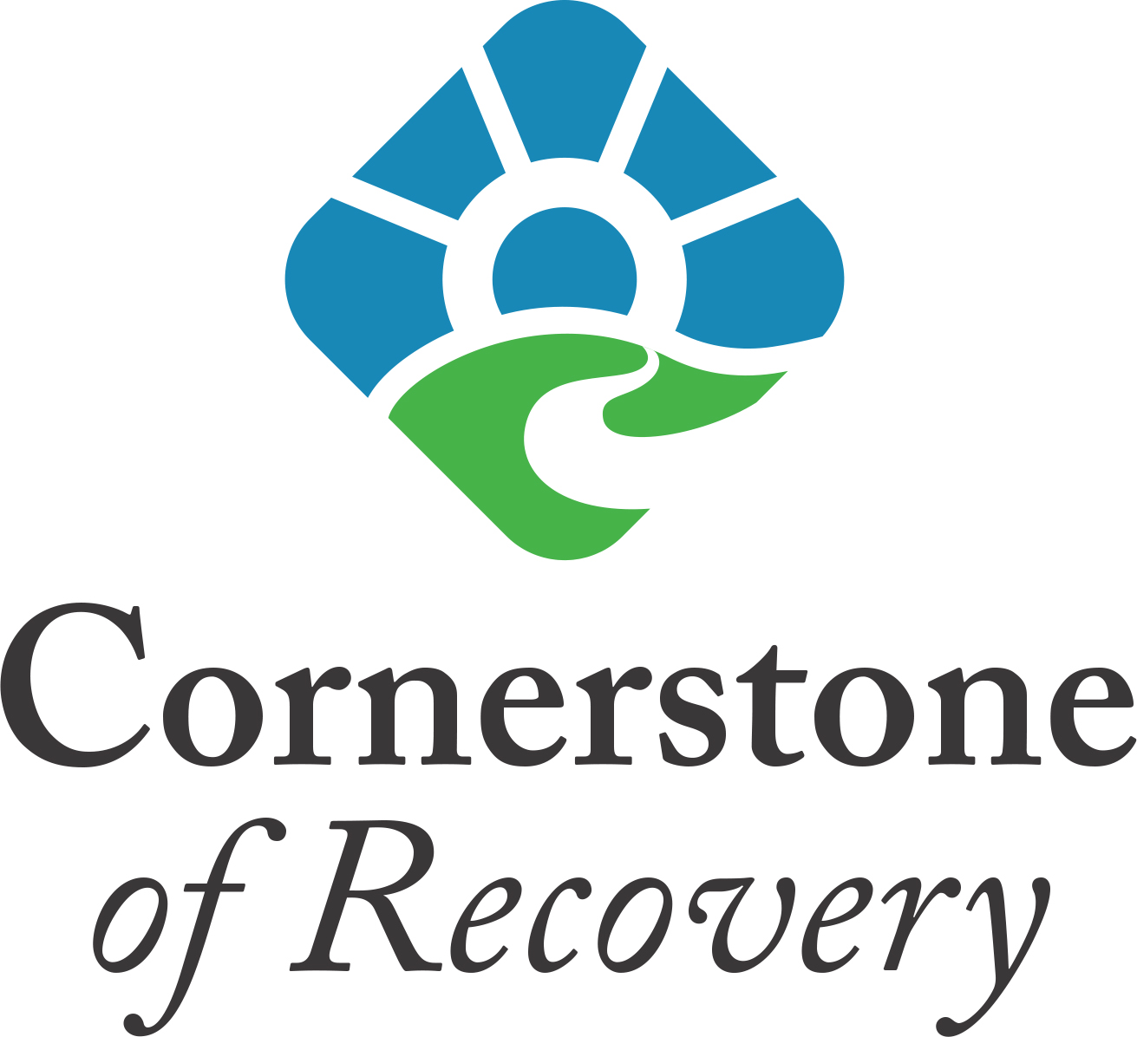
What Constitutes/Defines “Disease”?
According to prestigious academic, scientific, medical, and governmental organizations; the American Medical Association, the American Psychiatric Association, The American Society of Addiction Medicine, The United States Department of health and Human Services, and the World Health Organization -
“A disease is a particular abnormal condition that negatively affects the structure of function of all or part of an organism, and that is not due to an immediate external injury. Diseases are often known to be medical conditions that are associated with specific signs and symptoms.”
“Disease: any harmful deviation from the normal structural or functional state of an organism, generally associated with certain signs and symptoms and differing in nature from physical injury. A diseased organism commonly exhibits signs or symptoms indicative of its abnormal state.”
© 2020, The Cornerstone of Recovery, Inc.

Slide 3
Addiction Defined
Layman’s terms: has to involve some kind of habitual behavior that sooner or later gets “out of control”
Qualification as a genuine addition: “bad habit” must also be something that is “unable to be stopped”, often from “painful withdrawal symptoms”, must cause a significant number of “serious problems” and produce major “negative consequences” for addict/alcoholic.
Dictionary definition: “to habitually devote oneself – or give oneself up – to a particular behavior or activity.
(Kesten, 2004)
© 2020, The Cornerstone of Recovery, Inc.

Slide 4
The Disease Concept
Chemical Dependency is……
PRIMARY
CHRONIC
PROGRESSIVE
INCURABLE disease characterized by…
LOSS OF CONTROL over alcohol and drugs
© 2020, The Cornerstone of Recovery, Inc

Slide 5
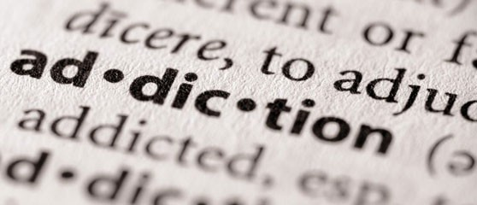
Primary
Meaning it comes first – Addiction is a disease that causes problems. Problems do not cause chemical dependency.
Example: Heroin Abuse (addiction is primary) caused Hepatitis from using shared needles (secondary).
© 2020, The Cornerstone of Recovery, Inc

Slide 6
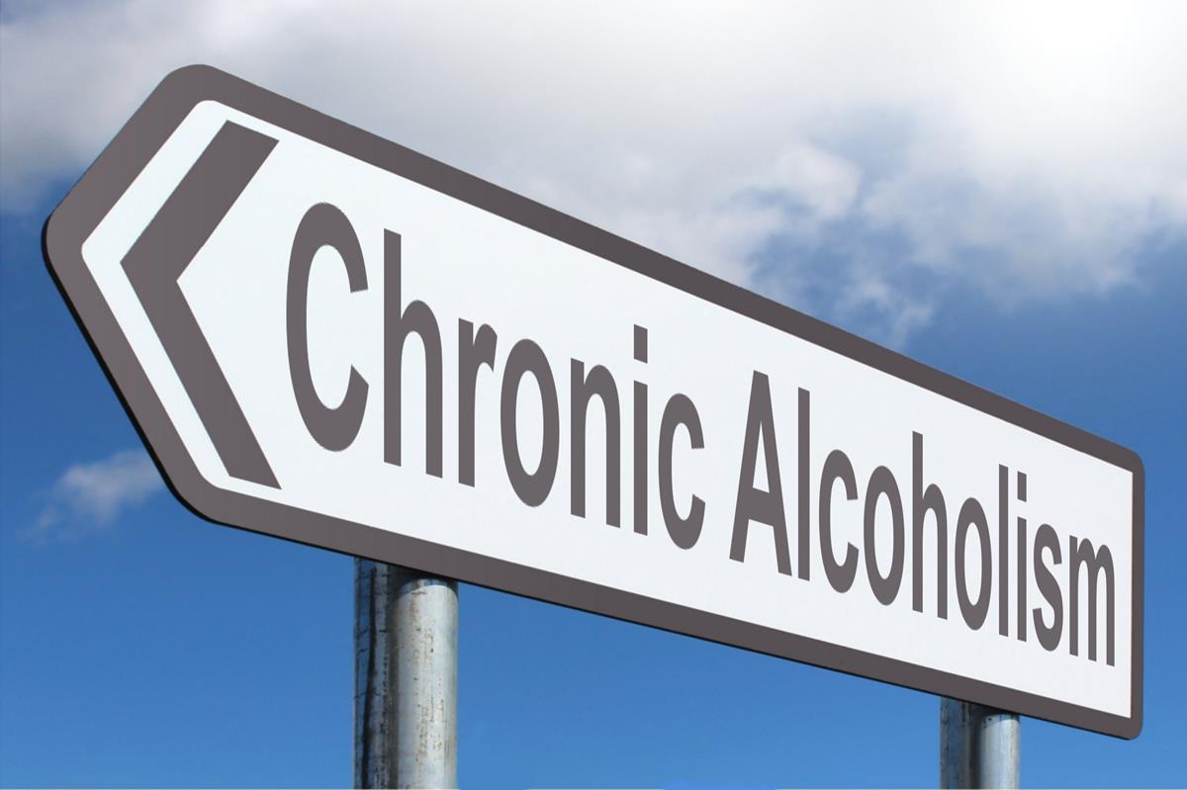
Chronic
This means it lasts a long time (at least a year to be considered chronic according to the Center for Disease Control).
Most people have the disease long before they receive treatment, which fools many people into resisting treatment in the early stage.
© 2020, The Cornerstone of Recovery, Inc

Slide 7
Progressive
It becomes worse with time.
Quits and goes back to it later, even years, the disease symptoms take up where the previous use left off. Never goes back to the beginning stage.
Can never be social drinkers or users.
© 2020, The Cornerstone of Recovery, Inc

Slide 8
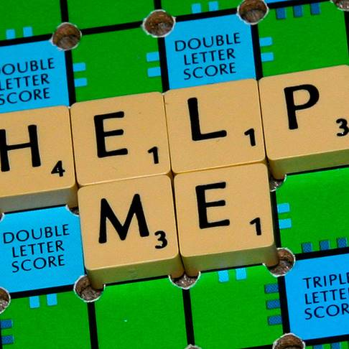
Incurable
The disease is ALWAYS there, whether there is use or not.
Can only be arrested (stopped from progressing) by not using or drinking.
Similar to allergic reactions
© 2020, The Cornerstone of Recovery, Inc

Slide 9
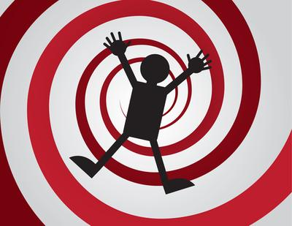
Loss of Control
Does not mean drunk/high every time used.
Means chemically dependent person can never PREDICT what will happen when they begin to drink or use.
No longer controls the alcohol or drug, the alcohol or drug controls the person.
Primary determining factor in separating chemically dependent from non-chemically dependent people.
© 2020, The Cornerstone of Recovery, Inc

Slide 10
Stigmas and Myths
Negative stereotypes: junkies, crackheads, drug addicts, alcoholic, drunk, loser
Moral stigma: weak, shameful, sinful, morally bankrupt, absence of strong values, lacks good character or moral fiber
Socially learned: a learned behavior that can just be unlearned, lack of adequate coping skills, “just stop”
© 2020, The Cornerstone of Recovery, Inc.

Slide 11
What is Addiction? Potentially fatal disease that can manifest itself in many ways
Denial
Dishonesty
Psychological Issues
Physical Dependence
Increased tolerance
Feelings of powerlessness
Depression
Shame
Fear
Anxiety
Hopelessness
Withdrawal symptoms
Criminal behavior
Change in personality
© 2020, The Cornerstone of Recovery, Inc.

Slide 12
Where Does Addiction Come From?
Partly hereditary – inherit proclivity from biological parents; interplay between hereditary trait, family structure, personality, and environment. Families that are shame based or where abuse occurs (sexual, physical, or emotional) have a high incidence of addiction.
Environmental – availability of drugs or alcohol, and amount of social pressure (modeled/learned behaviors).
© 2020, The Cornerstone of Recovery, Inc.

Slide 13
The Family Disease
Spouses often feel responsible for their partner’s addictions
Parents feel responsible for the children’s addictions
Children of addicted parents often suffer abuse or/and neglect
Children of addicted parents often develop addictions of their own later in life
Families feel they need to keep the addiction a secret out of shame, fear of judgement, rejection, pride, protection, and fear of financial consequences
Families become controlling and rigid, yet feel powerless, hopeless, and depressed
Families isolate and often break apart
© 2020, The Cornerstone of Recovery, Inc
© 2020© 2020, The Cornerstone of Recovery, Inc
, The Cornerstone of Recovery, Inc
© 2020, The Cornerstone of Recovery, Inc.
© 2020, The Cornerstone of Recovery, Inc.

Slide 14
Stages of Change
© 2020, The Cornerstone of Recovery, Inc.

Slide 15
STAGE 1 – EXPERIMENTAL USE
Only accounts for 1st or 2nd time use
Spontaneous, no planning, no money spent.
Group use only, peer pressure is extreme
Nicotine and alcohol for young people
Prescription and Over The Counter drugs for adults
Can go through all 5 stages with a single drug
Intervention process is education
© 2020, The Cornerstone of Recovery, Inc.

Slide 16
STAGE 2 - REGULAR USE
All use starts as a solution
A lack of negative consequences
Planning and consideration involved
Money is being spent to use.
Involves over 90% of users
Rx, OTC drugs, alcohol, cannabis.
Routes of ingestion - swallowing
Intervention process is education
© 2020, The Cornerstone of Recovery, Inc

Slide 17
STAGE 3 - TRANSITION
Increasing tolerance
Negative consequences begin, but are
denied being associated with chemical use
Changing peer group
Separation and social isolation
Length of stage can vary
Interventions occur almost by accident
EAP is essential
© 2020, The Cornerstone of Recovery, Inc

Slide 18
STAGE 4 – EARLY DEPENDENCE
Consequences are progressively worse
The user has little awareness of the addiction; clear to everyone else.
Excuses and externalizing become the norm
Added route of ingestion – snorting/sniffing
Tolerance is extreme requiring higher doses
Hallucinogens, designer drugs, etc. begin
Peer group has almost completely changed
Most intentional interventions occur at this stage
© 2020, The Cornerstone of Recovery, Inc

Slide 19
STAGE 5 – FULL DEPENDENCE
Aware of addiction and feel completely hopeless and helpless to stop it
Unable to function without using
Added route of ingestion – IV use
Tolerance may drop suddenly after lengthy history of increasing tolerance, which can lead to overdose.
Jails, institutions, and death are often the consequences at this stage
Formal treatment, support groups, ongoing assessments, family involvement, and therapy, are necessary and is the treatment process.
© 2020, The Cornerstone of Recovery, Inc

Slide 20
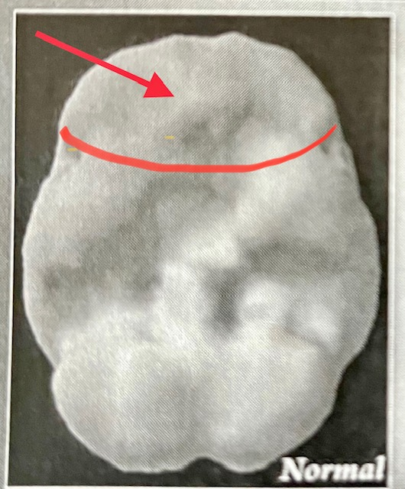
Prefrontal Cortex Prefrontal Cortex Functions
Attention Span
Judgement
Impulse Control
Organization
Forward Thinking
Internal Supervision

Slide 21
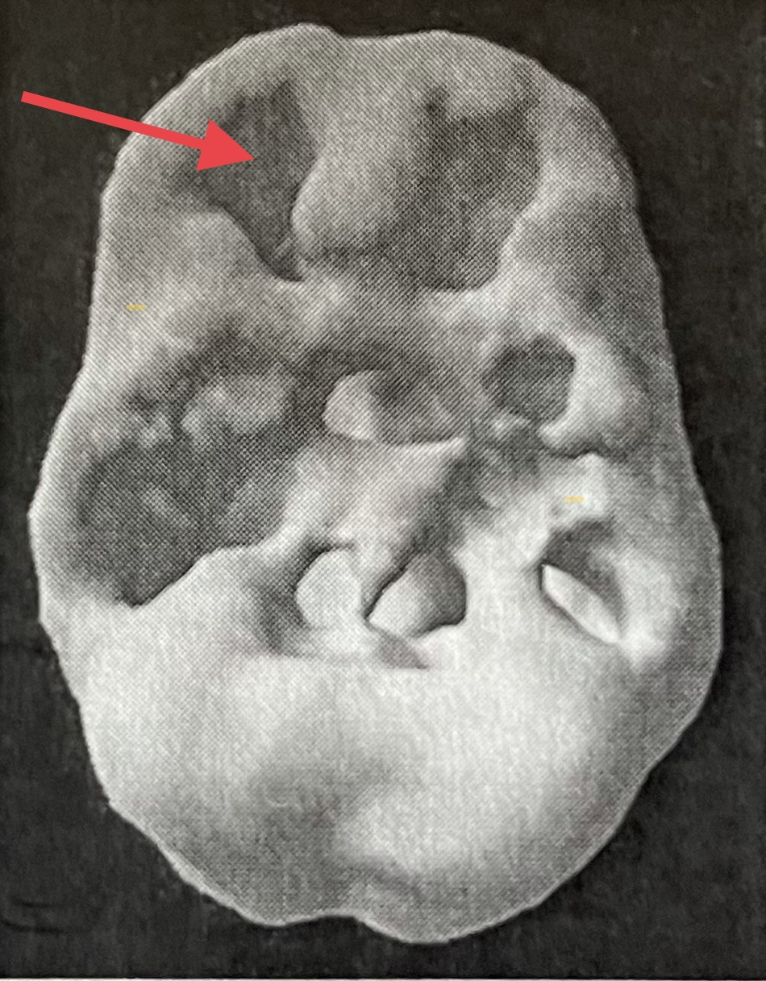
Prefrontal Cortex
Prefrontal Cortex Problems
Short Attention Span
Impulsivity
Procrastination
Disorganization
Poor Judgement
Lack of Empathy
Lack of Insight

Slide 22
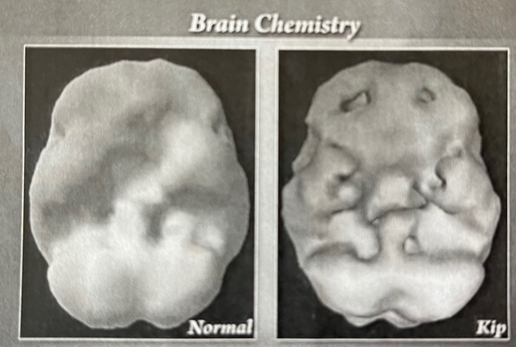

Slide 23
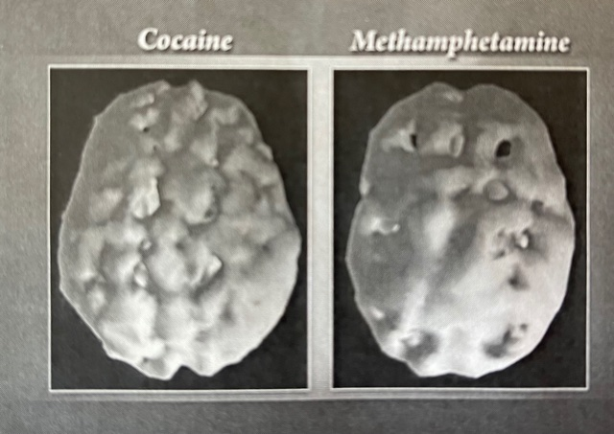

Slide 24
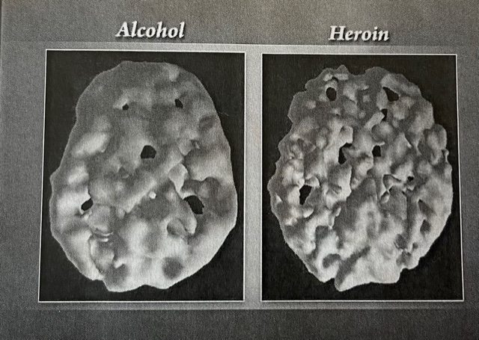

Slide 25
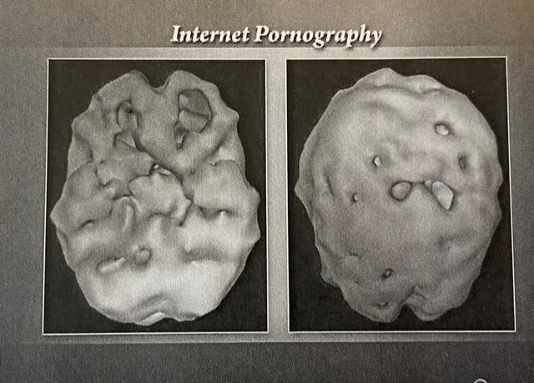

Slide 26
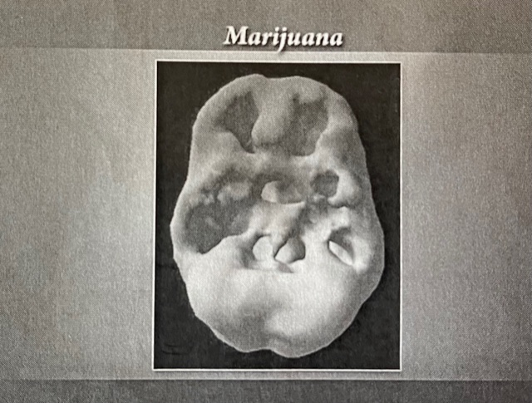

Slide 27
Getting Help
Seek treatment, in a hospital or treatment center
Alcoholics Anonymous
Al-Anon
Alateen
Adult Children of Alcoholics
This Photo by Unknown Author is licensed under CC BY

Slide 28
References
Keston, D. (2004). Addiction, Progression & recovery: Understanding the stages of change on the addiction recovery learning curve. PESI Healthcare, LLC.
Lee, B. (n.d.) Can you see it? Stages of addiction. Cornerstone of Recovery.
Lyles, M. (n.d.). Neurobiology of the Brain and Addiction. [video presentation]. Liberty University.
Ridgeview Institute. (n.d.). The Disease of Addiction. Smyrna, GA.

Slide 29
Thank you.
Presenter contact info:
Danyelle C. Smith, MA, LPC-MHSP, NCC
865-970-7747 x4050
danyellesmith@cornerstoneofrecovery.com
To make a referral, or for more information:
865-970-7747
cornerstoneofrecovery.com
© 2020, The Cornerstone of Recovery, Inc.

